Slide 1
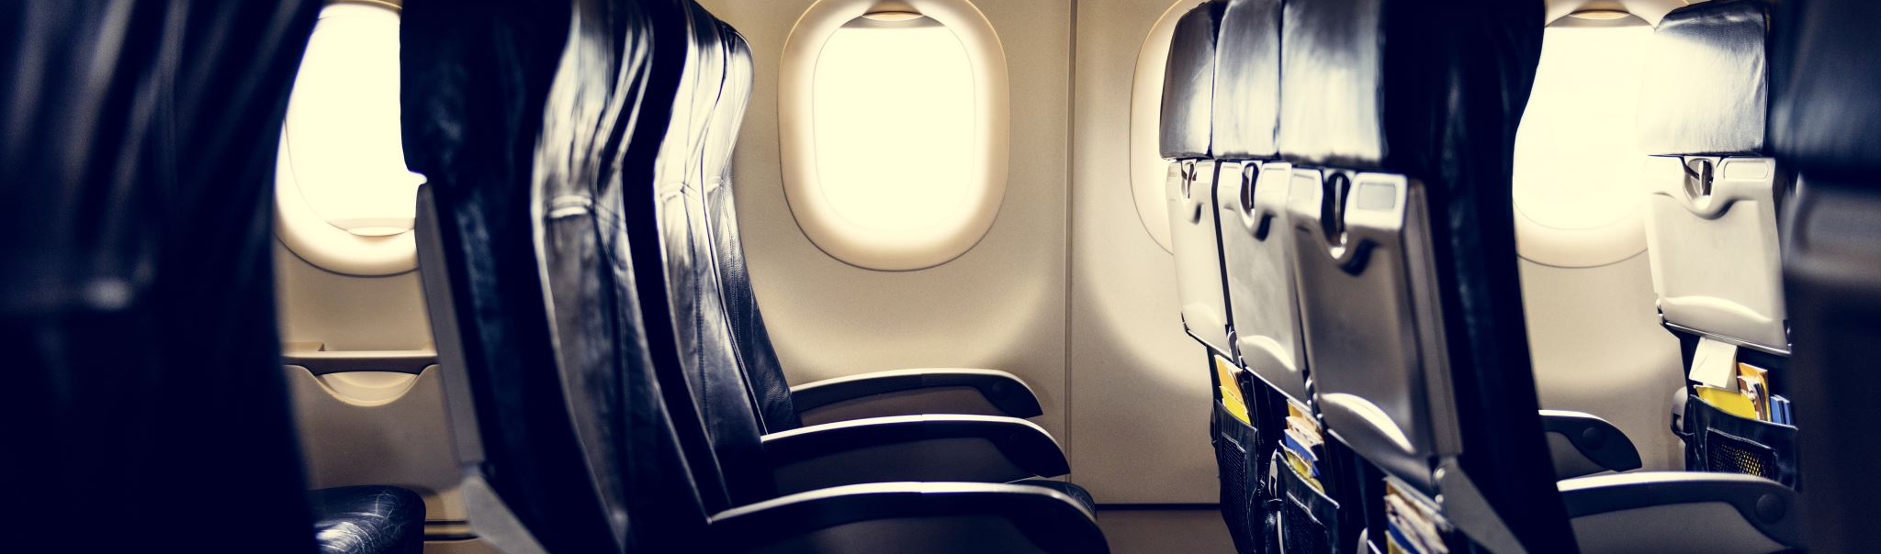
Airline Delays
Dataset for EEUU airlines from 2019-2020

Slide 2
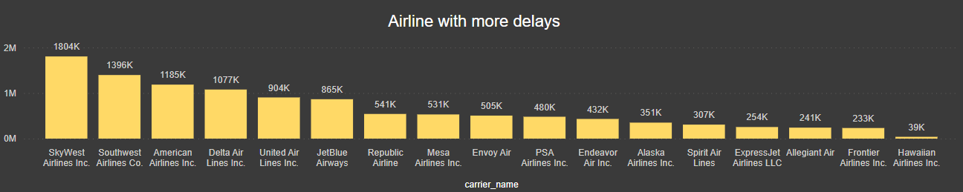
Witch Airline has the most delays?
As we can see in the next chart the Airline SkyWest has more than 1.8 millions minutes on delay, what is more than 3000 hours of people waiting.
And Hawaiian Airlines has less than 40k minutes of people waiting.

Slide 3
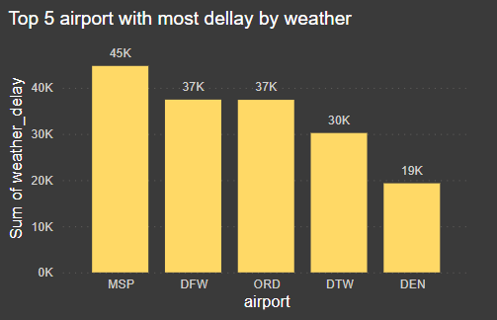
Witch Airports has the most delays by weather?
The Airports with most delays by weather in minutes are:
MS P : Minneapolis-St. Paul international.
DFW: Dallas/Fort Worth International.
ORD: Chicago O’hare International.
DTW: Detroit Metropolitan Wayne County.
DEN: Denver International.

Slide 4
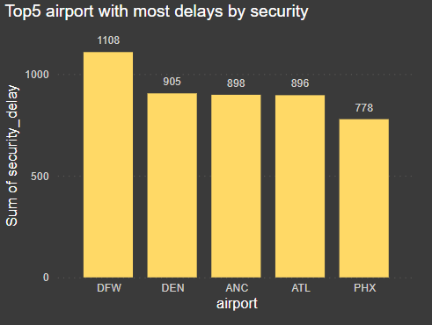
Witch Airports has the most delays by security?
The airport with most delays by security in minutes are:
DFW: Dallas/Fort Worth International.
DEN: Denver International.
ANC: Ted Stevens Anchorage International.
ATL: Hartsfield-Jackson Atlanta International.
PHX: Phoenix Sky Harbor International.

Slide 5
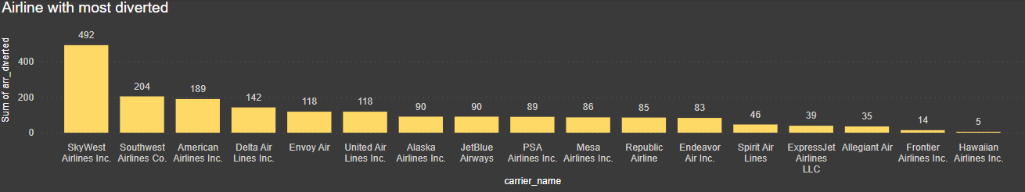
Witch Airline has most diverted?
As we can see the airline SkyWest is the one that has most diverted with almost 4 times more than the other airlines. Average of all airlines is 113.23.

Slide 6
Comparing this data with the number of flights they do we can realise that even if Southwest is the second airline with most delay, as well is the one with most flight.
But in really if we compare the Number of flights with the average delay per flight, we can see that even Southwest is the second airline with most flights and the second airline with less delay per flight, less than 10 mins.

Slide 7
So, in proportion the airline with most delay and with the smaller number of flights it is ExpressJet Airlines followed by SkyWest and JetBlue.

